Slide 1

Student Record Manager
A Cornerstone C++ Project
TEAM 8
Karishma 25B11CS360
Mounika 25B11CS418
Raghuveer 25B11CS426
Lokesh 25B11CS434

Slide 2
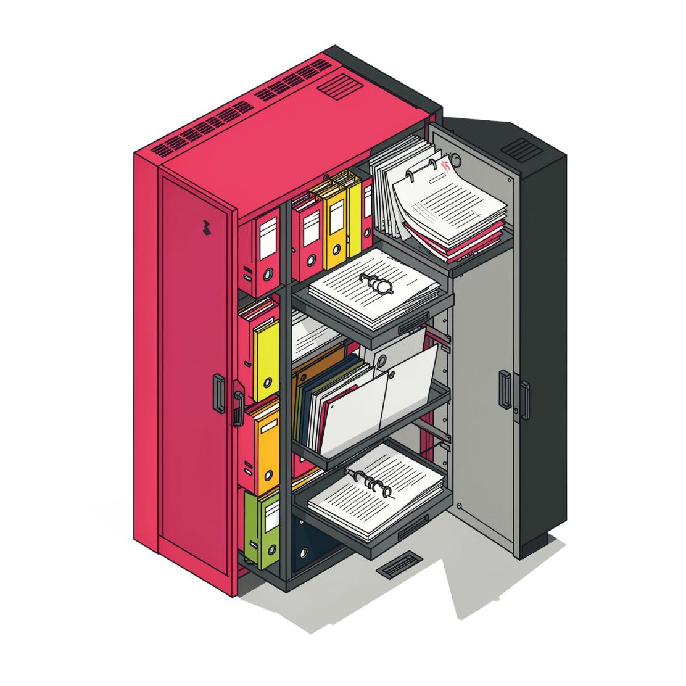
Project Abstract
A C++ console application designed to store and manage student information efficiently, replacing manual record-keeping with a centralized digital system.
Centralized Storage
Replaces scattered paper files and spreadsheets with a single organized system
Comprehensive Data
Stores Student ID, name, age, gender, course, department, contact info, and marks

Slide 3

Problem Statement
⏱ Time-Consuming
❌ Error-Prone
Manual record maintenance drains administrative time and resources daily
Human errors in data entry lead to inaccurate and inconsistent student records
🔍 Hard to Scale
Searching, updating, and deleting records becomes impractical as data grows

Slide 4

Project Objectives
1
Develop
Build a functional Student Record Manager using core C++ features
2
Organize
Store student information in a structured, accessible format
3
Operate
Develop Manager
Organize Records
CRUD Operations
Menu Interface
Implement add, display, search, update, and delete operations
4
Simplify
Each objective builds toward a complete, user-friendly record management solution.
Reduce manual effort with a clean menu-driven interface

Slide 5
Scope of the Project
Roadmap
Target
Environments
1
2
Schools
3
Manage student rosters and basic academic records
1
Current Version
Colleges
Basic student details and core CRUD operations
Handle large-scale student data across departments
2
Phase 2
Training Institutes
Attendance tracking and marks / grade management
Track participants in courses and academic programs
3
Future
Fees management and automated report generation

Slide 6
Existing System vs. Proposed System
❌ Existing System Limitations
✅ Proposed System Features
Unmanageable at Scale
Error & Duplication
Menu-Driven Interface
Validated Input
Manual data entry introduces mistakes and duplicate records
Add new student records with built-in input validation
Paper files and spreadsheets break down as student numbers grow
Intuitive C++ console application with clear navigation
Full CRUD Operations
Persistent Storage
Slow Retrieval
Physical Risk
Display, search, update, and delete records with ease
File handling ensures data is saved permanently between sessions
Searching through a large number of manually maintained records takes more time
Storage requirements grow and records risk being lost or misplaced

Slide 7
Functional Requirements
01
02
03
FR1 — Add Student
FR2 — Display Students
FR3 — Search Student
Enter and save new student details with validation checks
Show all stored records in a formatted, readable list
Find a specific student record quickly by Student ID
04
05
FR4 — Update Student
FR5 — Delete Student
Modify any field in an existing student record
Permanently remove a student record from the system

Slide 8
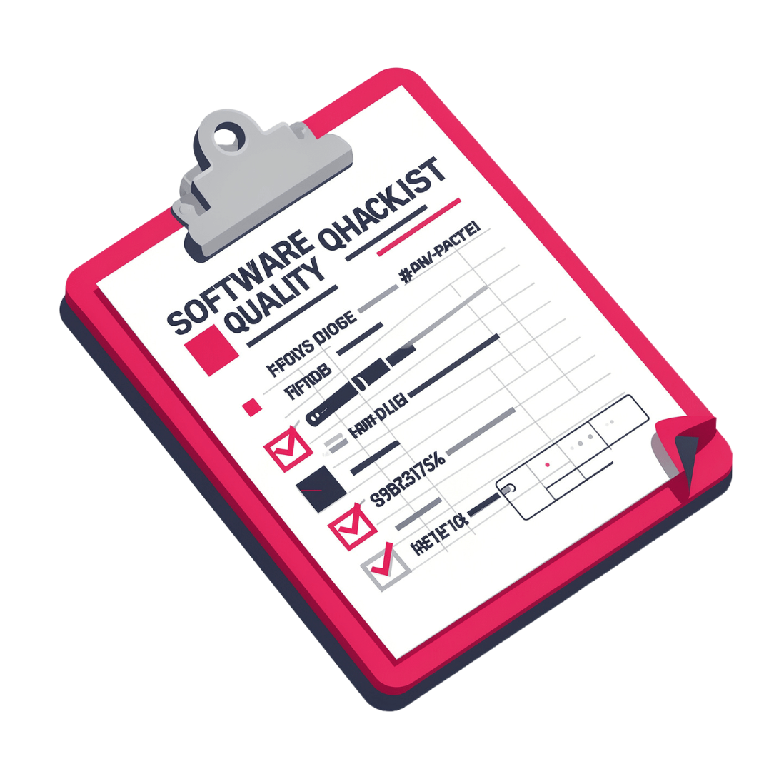
Non-Functional Requirements
Usability
Performance
Reliability
Simple menu with clear prompts and messages for all users
Fast search and operations for typical academic data volumes
Proper handling of invalid inputs without crashes
Maintainability
Modular, well-structured code that is easy to extend

Slide 9
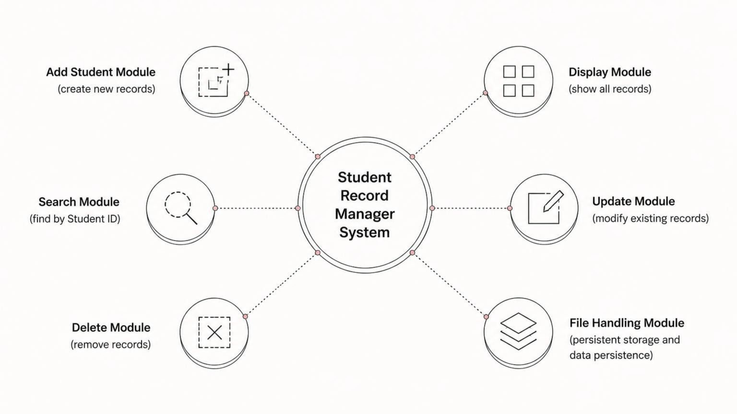
System Modules
The system consists of six main functions: Add, Display, Search, Update, Delete, and File Handling for persistent storage.

Slide 10
Data Structure Design
Student Class Attributes
Core C++ Design Decisions
Attribute
Type
Class & Object
Vector<Student>
Student class encapsulates all data fields and member functions for clean OOP design
STL vector manages dynamic collections of multiple student records in memory
studentId
string
name
string
age
int
File I/O
gender
string
fstream-based file handling ensures permanent data persistence across sessions
course
string
department
string
phone / email
string
marks
float

Slide 11





Implementation Approach
The Student Record Manager is built on a clean, modular C++ architecture — each functional requirement maps directly to an independent module, ensuring the system is easy to develop, test, and extend.
Design Class
Define Student class with all attributes and methods
Build Modules
Implement Add, Display, Search, Update, Delete functions
Add File I/O
Integrate persistent storage with fstream read/write
Test & Validate
Verify all operations with edge cases and invalid inputs

Slide 12
Key C++ Concepts & Implementation
Data Structures
Modular Functions
File Handling
vector<Student> stores records dynamically, with fields: ID, name, age, gender, course, department, contact, and marks.
Separate functions for each CRUD operation ensuring code reusability and clean architecture.
File I/O operations for persistent data storage between application sessions.
Input Validation
Control Flow
Error checking for duplicate IDs, invalid data types, and boundary conditions.
Switch-case statements for menu navigation and conditional logic for data operations.

Slide 13

System Workflow & Architecture
Execute Operation
Add/Display/Search/Update/Delete
Validate Input
Check user entries
Show Menu
Display core operations
Main System Flow
Start
Launch application
User launches the Student Record Manager
Menu interface displays five core operations
User selects Add, Display, Search, Update, or Delete
System processes input with validation checks
Data stored/retrieved via file-based persistent storage
Results displayed in formatted output
User returns to menu or exits
Input Validation
CRUD Operations
Duplicate IDs & type checks
Add, Display, Search, Update, Delete
File Handling
Menu Interface
Persistent storage across sessions
Switch-case driven navigation

Slide 14
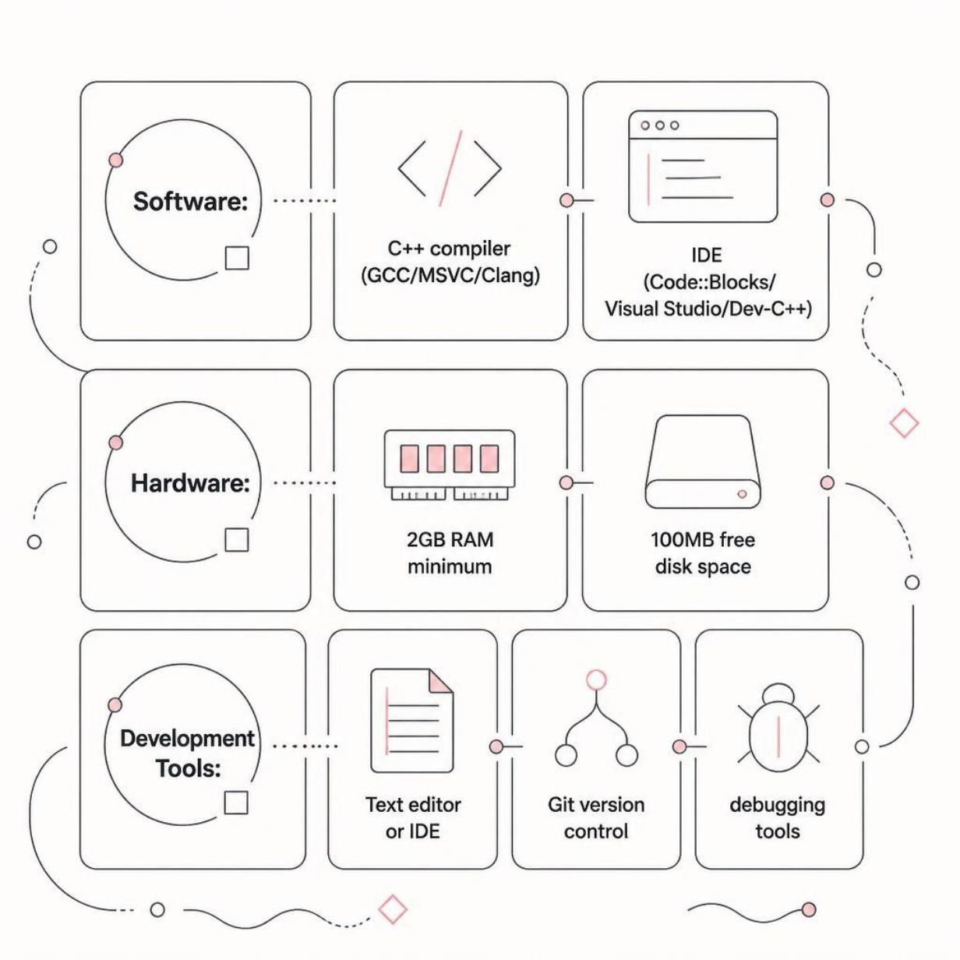



Hardware & Software Requirements
Hardware
Any modern processor (Intel/AMD)
4 GB RAM or above
Minimal storage — under 100 MB
Software
Windows / Linux / macOS
C++ compiler (GCC, Clang, or MSVC)
VS Code, Code::Blocks, or Visual Studio
Future Enhancements
GUI development for improved usability
Database integration (SQL backend)
Advanced reporting and analytics features

Slide 15
Review-2: Implementation Progress
Student Record Manager • Team 8 • C++ Console Application
1 Completed
Modules
2 Code & Functions
3 C++ Concepts
4 Presentation
Explain the functions
completed so far and
connect each function to
its module.
Include the execution
flow and representative
outputs.
Demonstrate relevant
concepts:
• Class & Object
• vector<Student>
• Functions
• fstream
• switch-case
• Input validation
Present the
implementation clearly
and explain each
member's actual
contribution to the
project.
Demonstrate the
completed modules:
• Add Student
• Display Students
• Search Student
• Update Student
• Delete Student
• File Handling
Review focus: implementation evidence + code explanation + output demonstration + individual contribution

Slide 16
Completed Modules
Six main functions described in the project design
Add Student
Display Students
Search Student
Collect and validate student details,
then store the record.
Show all stored records in a
formatted, readable list.
Locate a record quickly using
Student ID.
Update Student
Delete Student
File Handling
Modify fields in an existing student
record.
Remove an existing student record.
Read/write records so data persists
across sessions.
Module mapping follows the project's stated system modules and functional requirements.

Slide 17
Code / Function Walkthrough
Representative excerpts aligned with the documented implementation modules
Student class + Add module
Search + Update + Delete
class Student {
public:
string studentId, name, gender;
string course, department;
string phoneEmail;
int age;
float marks;
};
void addStudent(vector<Student>& students) {
Student s;
// read + validate fields
// reject duplicate Student ID
students.push_back(s);
}
int findStudent(const vector<Student>& v, string id) {
for (int i = 0; i < v.size(); ++i)
if (v[i].studentId == id) return i;
return -1;
}
// update: locate index, then edit fields
// delete: locate index, then erase(v.begin()+i)
Menu control flow
File handling
switch(choice) {
case 1: addStudent(students); break;
case 2: displayStudents(students); break;
case 3: searchStudent(students); break;
case 4: updateStudent(students); break;
case 5: deleteStudent(students); break;
}
fstream file("students.dat",
ios::in | ios::out | ios::app);
// write records when saving
// read records when loading

Slide 18
Output Demonstration
Representative console outputs for the completed modules
Main menu + Add Student
Search / Update / Delete
===== STUDENT RECORD MANAGER =====
1. Add Student
2. Display Students
3. Search Student
4. Update Student
5. Delete Student
6. Exit
Enter choice: 1
Student ID: 25B11CS434
Name: Lokesh
Age: 20
Course: CSE
Marks: 82.5
Student added successfully!
Enter choice: 3
Enter Student ID: 25B11CS434
Record found:
Name : Lokesh
Marks: 82.5
Enter choice: 4
Record updated successfully!
Enter choice: 5
Record deleted successfully!
What to demonstrate live
Run the program → choose a menu option → enter data → show the result → repeat for Search/Update/Delete →
show that file handling preserves records.
Note: these are representative outputs for presentation; replace values with your actual program output if different.

Slide 19
Relevant C++ Concepts Demonstrated
Connect each concept to the implementation
Class & Object
vector<Student>
Modular Functions
Student class encapsulates
student attributes and member
behavior.
STL vector stores a dynamic
collection of student records in
memory.
Separate functions support Add,
Display, Search, Update and Delete.
File I/O
Switch-Case
Input Validation
fstream supports persistent storage
between application sessions.
Menu selection routes the user
to the required operation.
Checks duplicate IDs, invalid types
and boundary conditions.

Slide 20



Student Record Manager
A C++ Console Application
THANK
YOU
Presented by :
Karishma
Mounika
Raghuveer
Lokesh

